Slide 1
Fire Detection Algorithm
Biton Dvir, Cohen Sahar, Farbstein Maayan

Slide 2
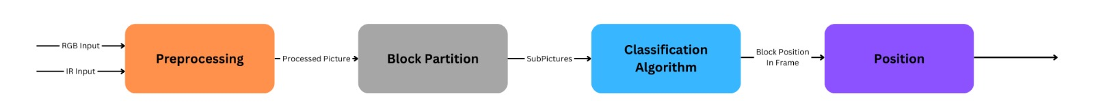
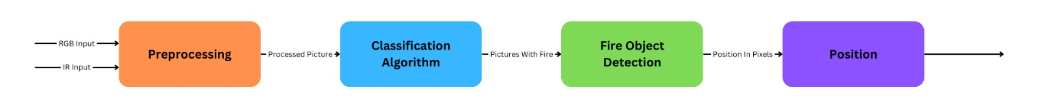
Preliminary Architecture Concepts
?
?

Slide 3
Wildland Fire Detection and Monitoring Using a Drone-Collected RGB/IR Image Dataset
By [XIWEN C., BRYCE H., HAO W., LEO O., FATEMEH A., ABOLFAZL R., PETER F., JANICE C., ERIC R., ADAM W.], [2022]
Flame2 dataset:
Side by side RGB + IR drone footages and videos
Both fire and not-fire footages and videos
Classification Models:
Inputs: IR / RGB / BOTH
CNN-s: ResNet18, VGG16, MobileNetV2, LeNet5, Flame (Custom)
Multimodality:
Late Fusion
Early Fusion

Slide 4
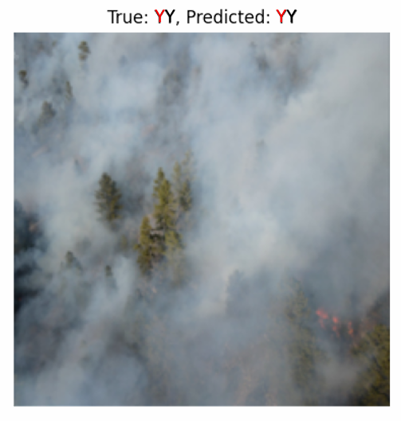
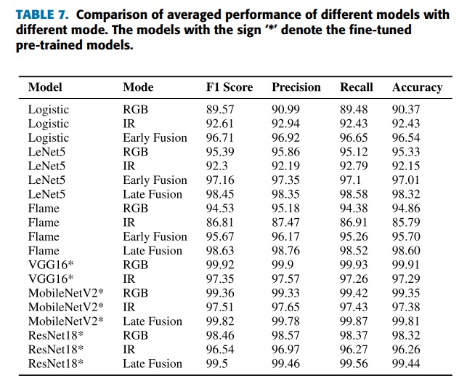
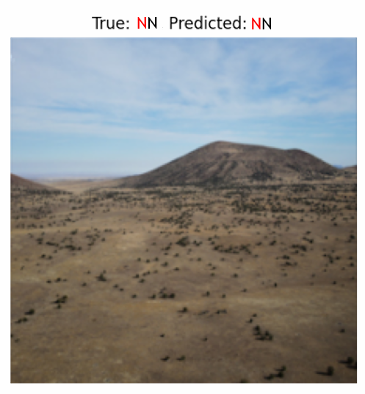
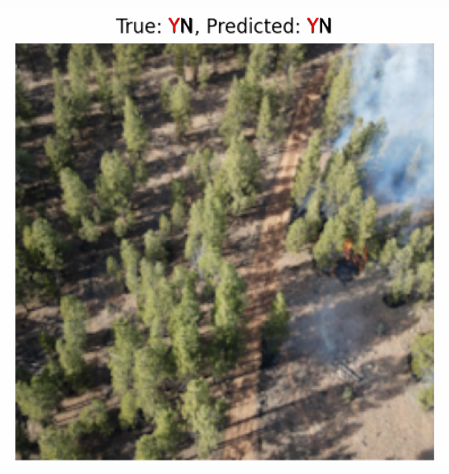
Image Classification Results from the Flame2 Dataset
X. Chen et al., "Wildland Fire Detection and Monitoring Using a Drone-Collected RGB/IR Image Dataset," in IEEE Access, vol. 10, pp. 121301-121317, 2022, doi: 10.1109/ACCESS.2022.3222805.

Slide 5
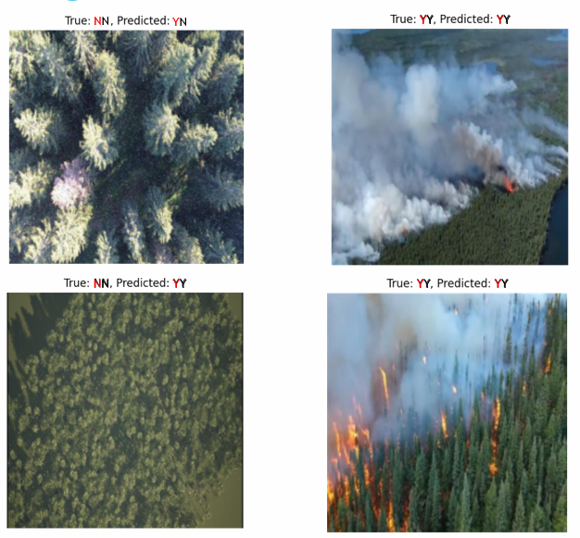
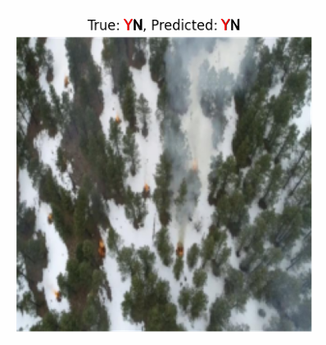
Image Classification Results New Dataset
Notes:
להכניס רפרנס/מקור

Slide 6
Training and Dataset Challenges
Limitations of the Existing Approach:
Paper’s models were trained on biased data (7 non-diverse videos)
Achieved good accuracy on the paper's dataset, but performance drops on new, unseen datasets
Future Directions and Enhancements:
Creating diverse image dataset by:
Collecting additional datasets
Organize them in a unified format
Adding synthetic datasets, generated using Blender
Training state-of-the-art models on a larger and diverse image dataset

